Slide 1
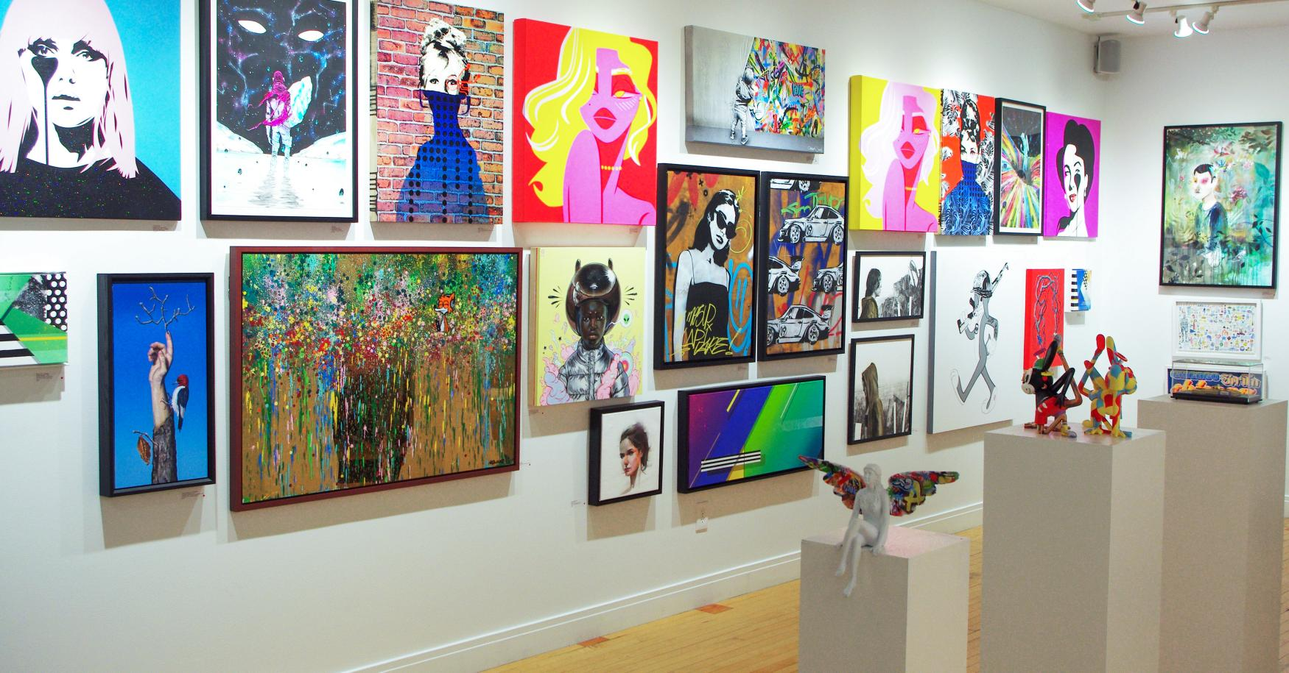
Art Gallery.
Faculty: DR. RAZIB HAYAT KHAN Course: Software Engineering Section: A Group-9
ID | Name
20-42221-1 | Subrina Khan Authoy
20-42438-1 | Kakon,Khairul Islam
20-43137-1 | Kaniz Fatima
20-43166-1 | Raihan Sikder Anik
20-44137-1 | Wasif Ahmed

Slide 2

OUTLINES
Introduction
Target Audience
Need and Opportunity
Purpose and functionality
Conclusion

Slide 3

Introduction
This program illustrates the management system of an Online Art Gallery. Utilizing this system, aesthetes can easily buy a painting from the app. Online Art Gallery management system is an application that allows buyers to purchase paintings.

Slide 4

Target Audience
Artist.
We welcome all the artist
Art lovers.
We welcome all the painting lover
Art traders.
We welcome all the painting buyers and sellers

Slide 5
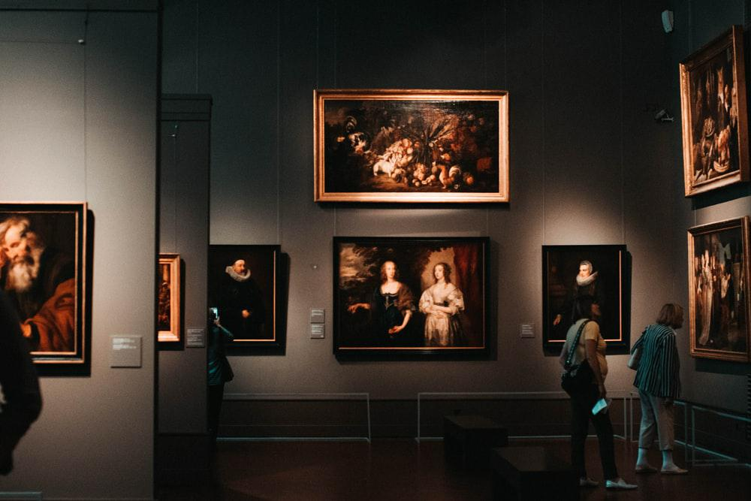
Need and opportunity
Need
Lack of platform in arts and crafts.
Approximate 12 art galleries in Dhaka.
Opportunity
Local artist will have a platform.
They can earn a lot.

Slide 6
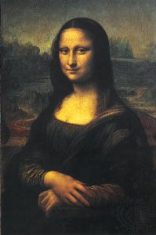
Purpose and functionality
Events
Several events per months
Fair
Hosting occasional fairs
Auction
Regular limited time auction

Slide 7

Conclusion
An art gallery is essentially the best way to establish the fundamentals for artists.

Slide 8


